Slide 1

Market & Competitor Analysis
Evaluating the landscape of household management solutions and identifying our strategic advantage.

Slide 2

The Current Market Landscape
Understanding existing solutions for shared households.

Slide 3
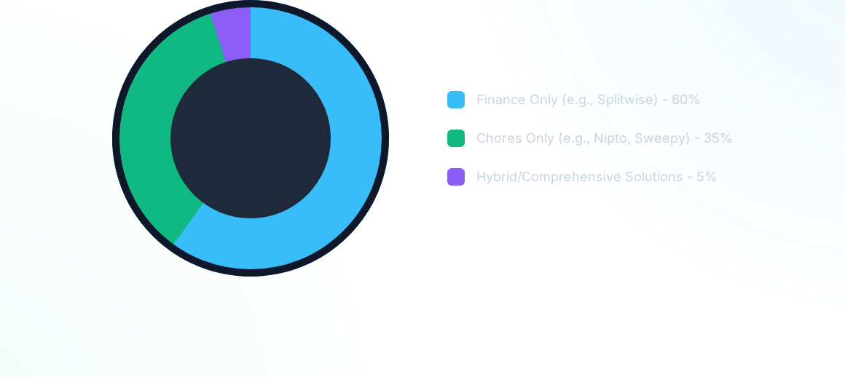
Market Fragmentation
The Core Problem: The market is heavily fragmented. Roommates are forced to use multiple, disconnected applications to manage interconnected household problems, leading to app fatigue and low adoption rates.

Slide 4







The "Finance First" Giants
Splitwise
Tricount
Settle Up
The absolute leader in the niche. Features a powerful debt simplification algorithm and supports complex group categorizations.
A highly popular minimalist service. Excellent for quick balance calculations without unnecessary features. Offline-first approach.
Similar core functionality to Splitwise. Differentiates with strong offline synchronization and custom exchange rates for travelers.

Slide 5


Deep Dive: Splitwise
Advantages (Pros)
Disadvantages (Cons)
Universal Adoption: The standard app everyone already knows.
Paid Receipt Scanning: OCR receipt parsing is locked behind a strict monthly paywall (Pro version).
Robust Algorithm: Flawless execution of debt simplification across complex group dynamics.
Zero Chore Management: Completely ignores the physical aspect of living together.
Multi-Group: Easily handles overlaps (e.g., apartments, trips, couples).
Mobile Focused: Lacks a robust, dedicated desktop client for household "terminals".

Slide 6



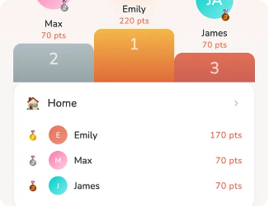
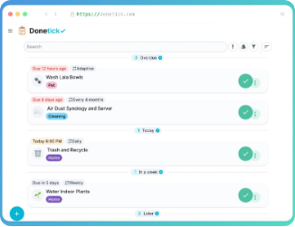
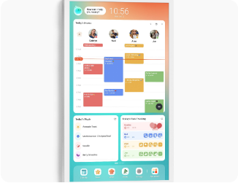
The "Chore First" Applications
Nipto
Sweepy / Tody
OurHome
Highly gamified experience. Users earn points for cleaning, creating competitive leaderboards among roommates.
Focuses on cleaning schedules based on room degradation. Generates daily to-do lists to keep the house tidy.
A family-oriented organizer with shared grocery lists, a robust chore calendar, and a reward system.

Slide 7

The Flaw in Chore Applications
While apps like Nipto and OurHome excel at distributing physical labor, they completely drop the ball when it comes to shared expenses.
Primitive Finances: If financial modules exist at all, they are basic ledgers with no debt simplification algorithms.
Dual App Necessity: Forces the household to rely on a secondary app (like Splitwise) to handle money, causing friction.
Lost Context: Disconnects the act of buying shared goods (groceries) from the act of using them (cooking/cleaning).

Slide 8

The Gap in the Market &
Our Strategic Position

Slide 9
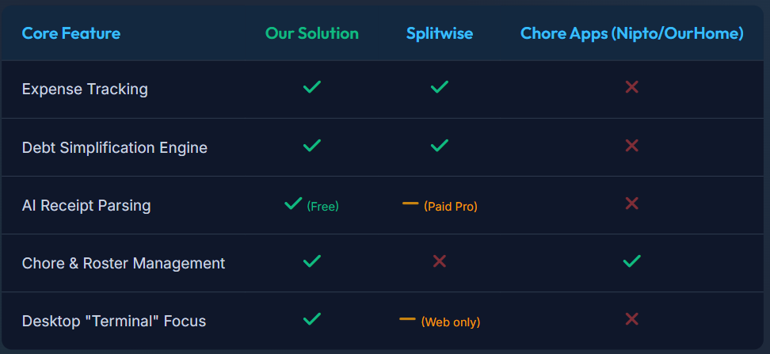
Competitive Feature Matrix

Slide 10



Our Competitive Advantages
All-in-One Solution
Free AI Capabilities
Desktop First
We solve the two biggest roommate pain points simultaneously. No more app fatigue. One central hub for debts and duties.
By utilizing the Gemini API, we offer automated receipt parsing out-of-the-box. A feature competitors lock behind expensive monthly subscriptions.
Designed as a WPF/Windows Forms application, perfect for a shared dorm PC acting as a central, transparent household terminal.

